Slide 1






WE TRAVEL INT222-ADVANCED WEB DEVELOPMENT
Ayush Amlesh
KM042B78
Faculty: Dr. Balwinder Kaur Dhaliwal

Slide 2
All about the web app
The design of this We Travel Express website considers the Indian culture's joint family system.
This web app lets you explore and plan your vacation.
Book your trip with us.
HTML, CSS, JS, and Nodejs are used to build this app.

Slide 3

TEMPLATES (.ejs)
MOUNTAIN
ADVENTURE
BEACHES
PILGRIMAGE

Slide 4
DEPENDENCIES USED

Slide 5
EJS
Embedded Javascript Templating is a templating engine used by Node.js. Template engine helps to create an HTML template with minimal code.
npm install ejs --save

Slide 6
express
Express is a minimal and flexible Node.js web application framework that provides a robust set of features for web and mobile applications.

Slide 7
nodemon
It is a program that assists in the development of Node.js-based applications by automatically restarting the node application when directory file changes are detected.

Slide 8
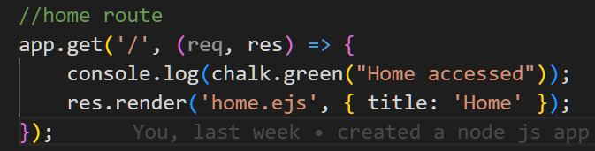
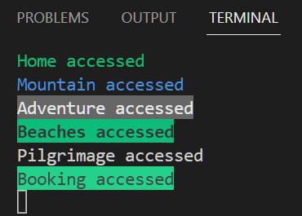
chalk

Slide 9
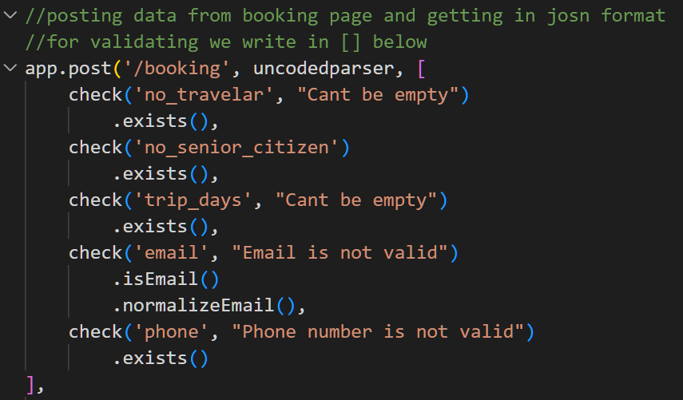
express-validator

Slide 10
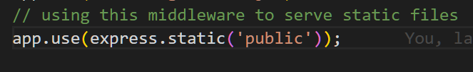
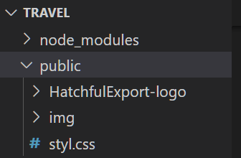
path

Slide 11
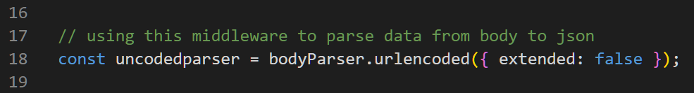
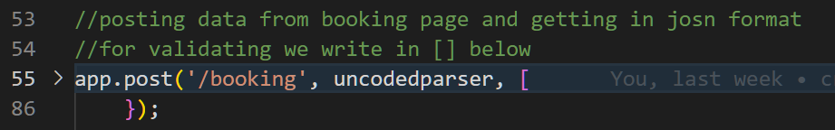
body-parser

Slide 12
WORKING OF THE WEB APPLICATION
npm start
Starts the server port from server.js
Localhost:2022
Redirect the app to home page
URL request
The app will go to server.js and then find the task to perform.

Slide 13
WORKING OF THE WEB APPLICATION
Form in action
It uses post method to send data
body-parser come into action
It will read the data from URL
Save the .txt file
By the help of fs.writeFileSync the booking file is created.

Slide 14
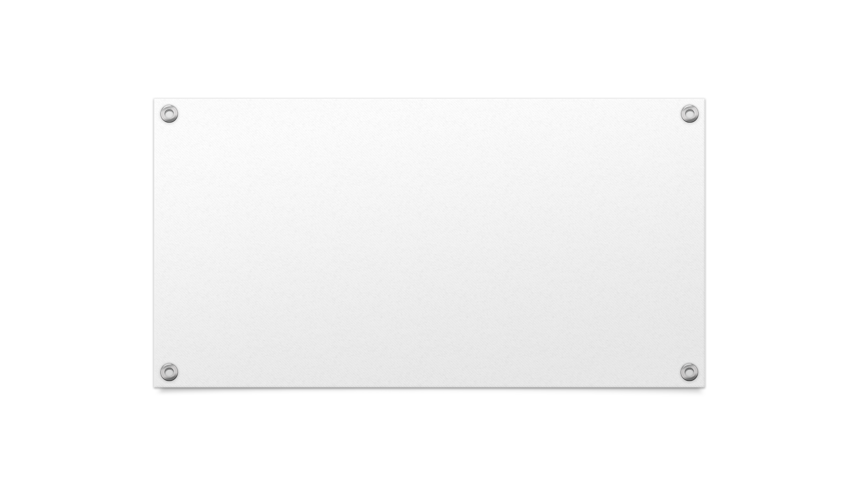

THANK YOU

